Slide 1

Domain-driven design With Clean Architecture
In A Nutshell
Don't Forget To Subscribe!
Source Code: https://bit.ly/your-source

Slide 2
The Problem & WHY THIS TOPIC

Slide 3
The Classic Patterns Are great but
Server-side technologies are providing us only a simple “front-end” pattern
So we decide to abstract the business logic
By extracting business logic to services
However, solutions with lots of business logic will get “spaghetti” in no time
Controllers/Components/Services with thousands lines of code
No concepts and strong separation
We often separate the HTTP logic from the business logic, but that’s it
We need to concentrate on the business logic
And do not care about infrastructure & presentation details
We need scalable solutions
Scalable in terms of development teams, not in terms of throughput

Slide 4
The Principles We Search For

Slide 5
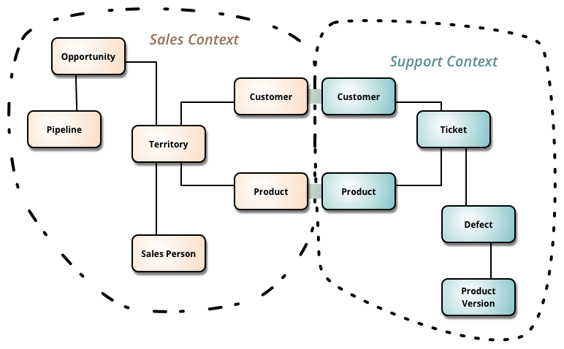
Our architecture needs
Separation of Concerns
Encapsulation
Dependency Inversion
Explicit Components
Single Responsibility
Don’t Repeat Yourself
Persistence & Infrastructure Ignorance
Presentation Ignorance
Bounded Contexts
Testability

Slide 6
Architecture abstraction
Layers:
System, Sub-systems, Layers, Components, Classes, Data and Methods
Bad Architecture:
Complex, Incoherent, Brittle, Untestable, Unmaintainable
Good Architecture:
Simple, Understandable, Flexible, Testable, Maintainable

Slide 7
Mentorship program ON Patreon
These videos are part of my mentoring program!
More information on Patreon: https://www.patreon.com/ivaylokenov
Target – junior to regular programmers with 0 to 2 years practical work
Help with:
Becoming better software developers
Code improvement in terms of quality and logic
Career choices and advancement
Interview preparation
And more
Approach – private groups, exclusive lessons, workshops, one-on-one meetings
Data structure performance, architecture

Slide 8
A few words about the Classic Database-centric Architecture

Slide 9
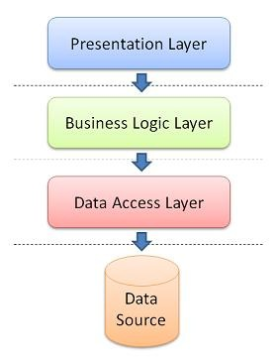
Database-centric Architecture
Database is the center of the application
The business domain and services are built around the database
It usually has the following layers
Presentation – Views or API
Business logic – external services or data-oriented
Data access layer – database-specific logic
The database is designed first
Application code comes secondary

Slide 10
Database-centric Architecture IS NOT BAD
Pros
Easy to learn
Most people understand it well
It covers most of our architecture needs
Cons
It is not flexible
It was designed for single presentation application (before smartphones)
It does not scale well – extracting microservices is a difficult task
All dependencies are towards the database

Slide 11



Any Questions?
Leave A Comment Below!
Don't Forget To Like The Video!

